Slide 1


Data Structures
ETCCDS202
Dr. Aarti
Faculty
School of Engineering & Technology
K.R. Mangalam University
Unit 2 : Linear Data Structures

Slide 2

Unit-2 Linear Data Structures
SESSION 11 Arrays – 1D & 2D
SESSION 12 Static & Dynamic Arrays
SESSION 13 Linked Lists Types
SESSION 14 Linked List Operations
SESSION 15 Stack ADT & Operations
SESSION 16 Stack Applications
SESSION 17 Queue ADT
SESSION 18 Queue Applications
SESSION 19 BFS using Queue
SESSION 20 Revision (Unit–2)
Notes:
New Courses replaced with New Programmes

Slide 3
Arrays – 1D & 2D
Session 11
Concept of Arrays
Need and Advantages of Arrays
Array Terminologies
Declaration and Initialization of Arrays
Accessing Array Elements
One-Dimensional Arrays (1-D Arrays)
Operations on 1-D Arrays
Two-Dimensional Arrays (2-D Arrays)
Memory Representation of 2-D Arrays
Traversal and Operations on 2-D Arrays
Comparison of 1-D and 2-D Arrays
Practice Problems and MCQs
Key Takeaways
Notes:
New Courses replaced with New Programmes

Slide 4
Learning Objectives
After this lecture, students will be able to:
Define an array and explain its characteristics
Identify array terminologies such as index, element, and length
Declare, initialize, and access 1-D arrays
Perform basic operations on 1-D arrays using programming constructs
Understand the structure and usage of 2-D arrays
Explain row and column indexing in 2-D arrays
Implement programs using 1-D and 2-D arrays
Apply arrays to solve simple computational and real-world problems
Notes:
New Courses replaced with New Programmes

Slide 5
Recapitulation (Unit-1: Data Structures & ADTs)
Data Structures: A data structure is a way to store, organize, and manage data efficiently
Helps in fast access, insertion, deletion, and processing
Real-world mapping:
Library system → List
WhatsApp chats → Queue
Undo operation → Stack
Need for Data Structures
Efficient data handling
Better performance
Reduced complexity in programs
Abstract Data Types (ADTs)
ADT defines what operations are performed, not how
Focuses on behavior and functionality
Examples: Stack (push, pop), Queue (enqueue, dequeue), List (insert, delete)
Notes:
New Courses replaced with New Programmes

Slide 6
Recapitulation (Unit-1: Time & Space Complexity)
Time Complexity
Measures how execution time grows with input size
Represented using:
Big-O (O) → Worst case
Theta (Θ) → Average/Exact case
Omega (Ω) → Best case
Space Complexity: Measures memory usage of an algorithm
Case Analysis: Best Case, Average Case, Worst Case
Common Time Complexities
O(1) → Constant time
O(log n) → Logarithmic
O(n) → Linear
O(n log n)
O(n²)
O(2ⁿ), O(n!)
Notes:
New Courses replaced with New Programmes

Slide 7
Recapitulation (Unit-1: Algorithm Design & Recursion)
Divide & Conquer
Divide problem → Solve subproblems → Combine results
Example: Merge Sort
Greedy Algorithm
Makes locally optimal choices
Fast but may not give global optimum
Dynamic Programming
Solves overlapping subproblems
Stores results to avoid recomputation
Used when Greedy fails
Recursion
Function calling itself
Requires:
Base case
Recursive call
Uses call stack to store function calls
Notes:
New Courses replaced with New Programmes

Slide 8
Recapitulation (Unit-1)
Q1. Which best defines a data structure? a) Programming language b) Method of organizing data c) Operating system d) Algorithm
Q2. Which of the following is an ADT? a) Array b) Stack c) Pointer d) Variable
Notes:
New Courses replaced with New Programmes

Slide 9
Recapitulation (Unit-1)
Q3. Which notation represents the worst-case complexity? a) Θ b) Ω c) O d) n
Q4. Time complexity of linear search in worst case is: a) O(1) b) O(log n) c) O(n) d) O(n²)
Notes:
New Courses replaced with New Programmes

Slide 10
Recapitulation (Unit-1)
Q5. Which complexity grows the fastest? a) O(n²) b) O(n log n) c) O(2ⁿ) d) O(n!)
Q6. Which technique avoids recomputing subproblems? a) Greedy b) Divide & Conquer c) Dynamic Programming d) Recursion
Notes:
New Courses replaced with New Programmes

Slide 11
Recapitulation (Unit-1)
Q7. Merge Sort follows which paradigm? a) Greedy b) Brute Force c) Divide & Conquer d) Dynamic Programming
Q8. What happens if a recursive function has no base case? a) Executes once b) Stops automatically c) Stack overflow d) Compiler error
Notes:
New Courses replaced with New Programmes

Slide 12
Recapitulation (Unit-1)
Quiz (Answers)
Q1: b) Method of organizing data
Q2: b) Stack
Q3: c) Big-O (O)
Q4: c) O(n)
Q5: d) O(n!)
Q6: c) Dynamic Programming
Q7: c) Divide & Conquer
Q8: c) Stack overflow
Notes:
New Courses replaced with New Programmes

Slide 13
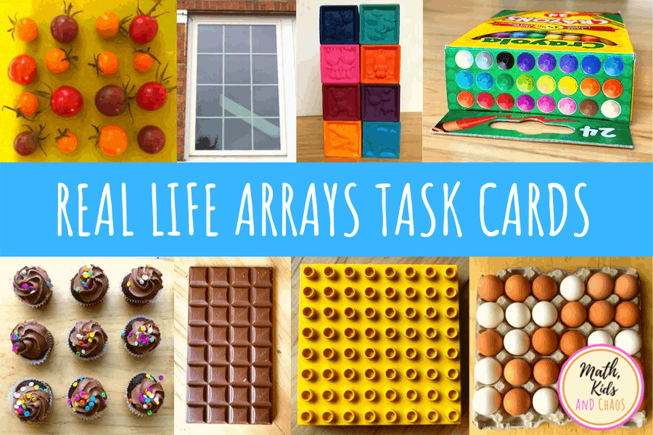
What is an Array?
An array is a collection of elements of the same data type
Elements are stored in contiguous memory locations
Fig.1: Examples of Array
Notes:
New Courses replaced with New Programmes

Slide 14
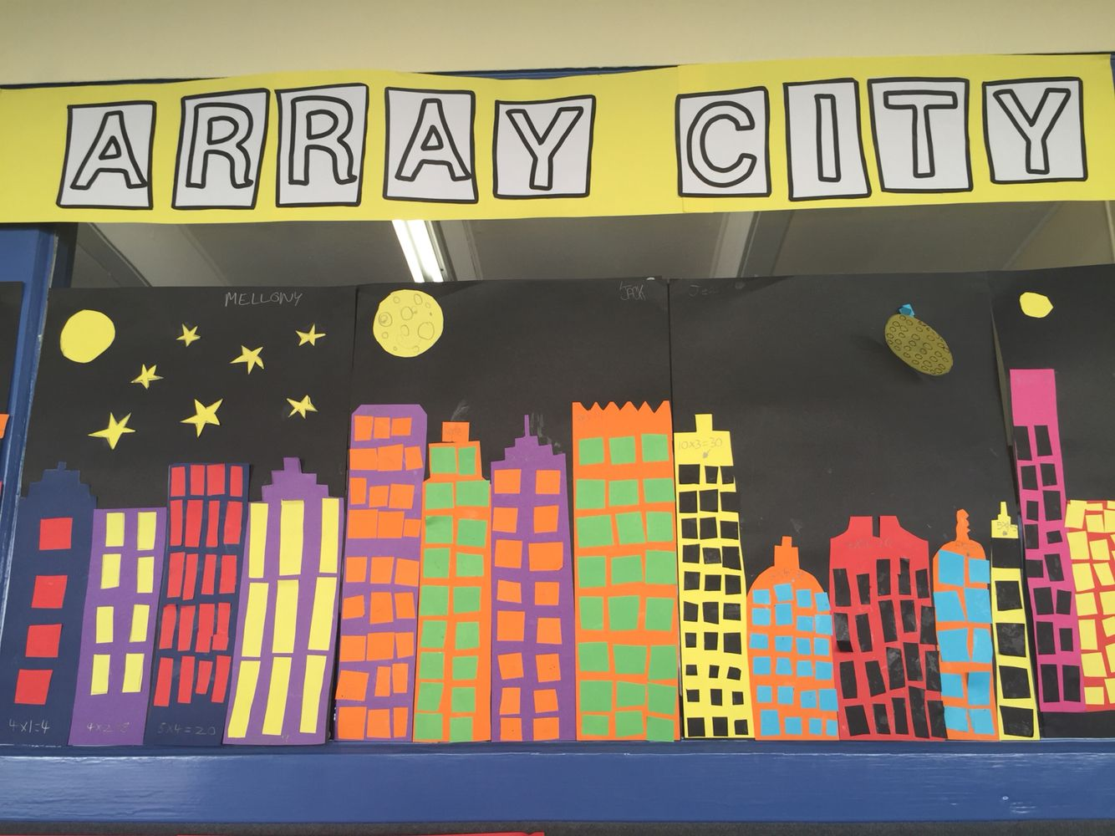
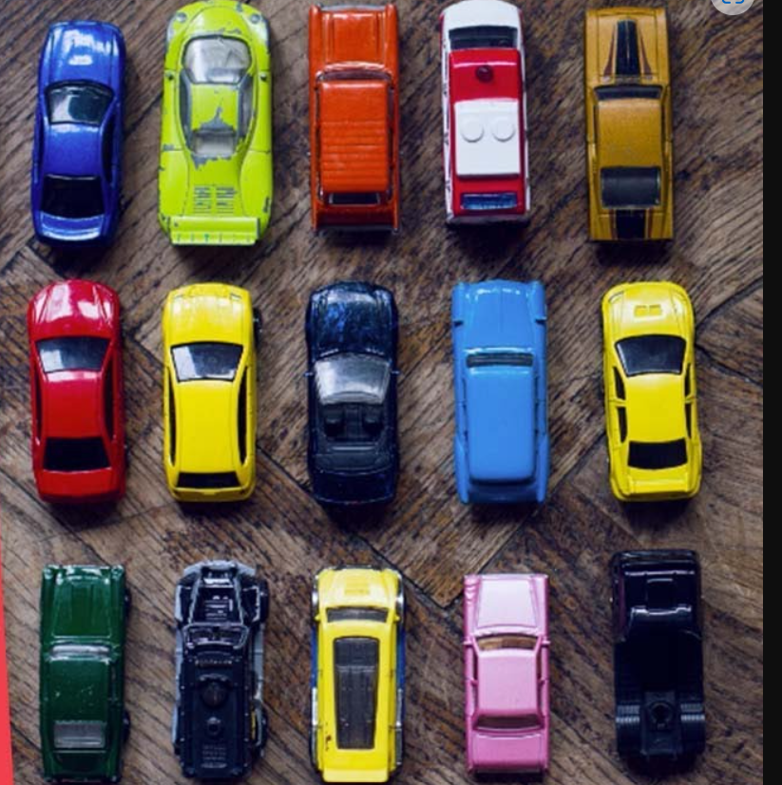
What is an Array? (Cont..)
Fig.2: Examples of Array
Notes:
New Courses replaced with New Programmes

Slide 15
Why Arrays are Used?
Efficient storage: Store multiple values using one variable name
Random Access: Easy access to data using an index
Iterative Operations
Reduces code length and complexity
Data Organisation
Foundation for Data Structure
Represent many instances in one variable
Notes:
New Courses replaced with New Programmes

Slide 16
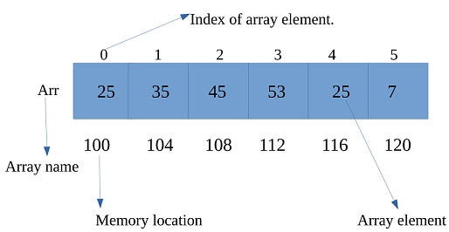
Indexing Concept
Linear data structure
Same data type elements
Contiguous memory allocation
Each element has an index number
Index usually starts from 0
Elements accessed using index value
Fig.3: Representation of an Array
Notes:
New Courses replaced with New Programmes

Slide 17
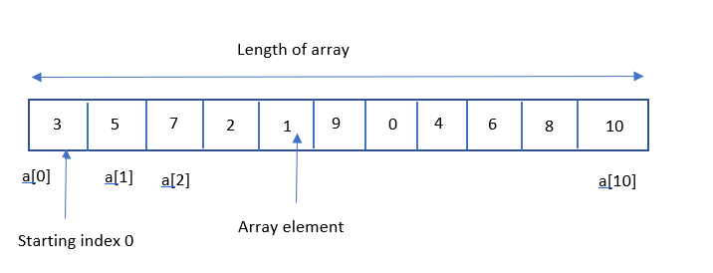
Test your knowledge
Ques: What is the length of the array shown in Figure?
Fig.4: Question on Array
Notes:
New Courses replaced with New Programmes

Slide 18
Basic Terminologies of array
Array Index - Each item in an array is indexed starting with 0. Each element in an array is accessed through its index.
Array Element - An array element is a single data item located at a specific index within an array.
Array Length - Array length is the total number of elements that an array can hold.
Notes:
New Courses replaced with New Programmes

Slide 19
Declaration of array
int arr[5]; // This array will store integer type element
char arr[10]; // This array will store char type element
float arr[20]; // This array will store float type element
Notes:
New Courses replaced with New Programmes

Slide 20
Initialization of array
int arr[] = { 1, 2, 3, 4, 5 };
char arr[5] = { 'a', 'b', 'c', 'd', 'e' };
float arr[10] = { 1.4, 2.0, 24, 5.0, 0.0 };
String names[5] = { “Bill”, “Susan”, “Jean”, “Piaget”, “Maria” }
Notes:
New Courses replaced with New Programmes

Slide 21
Accessing Elements
print(numbers[0])
print(numbers[1])
print(numbers[2])
Notes:
New Courses replaced with New Programmes

Slide 22
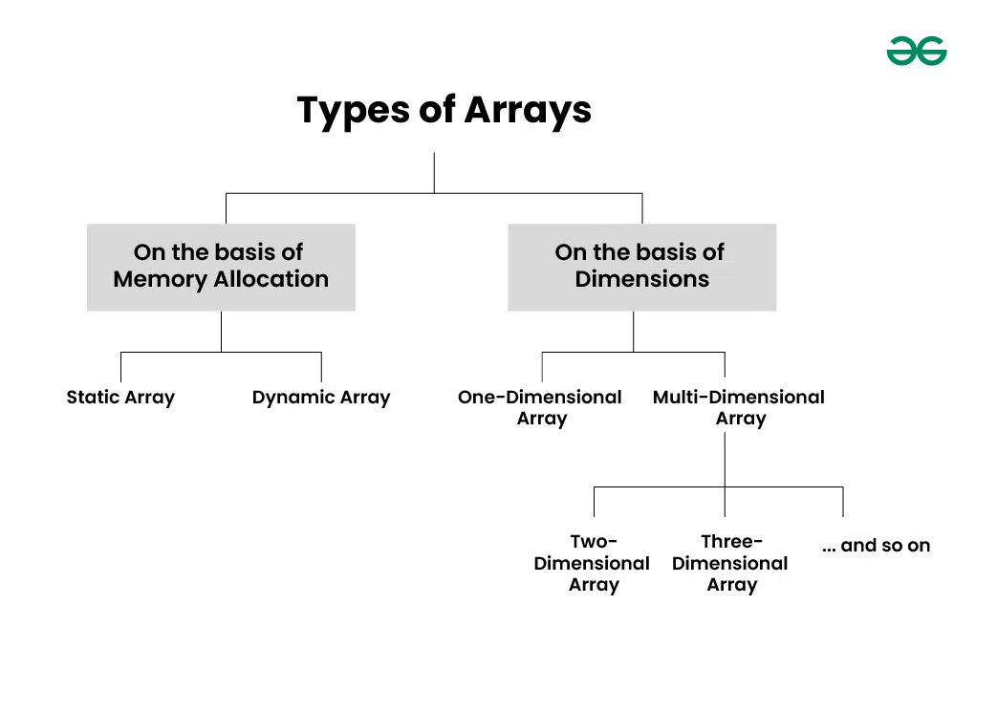
Classification of arrays
Fig.5: Types of Arrays
Notes:
New Courses replaced with New Programmes

Slide 23
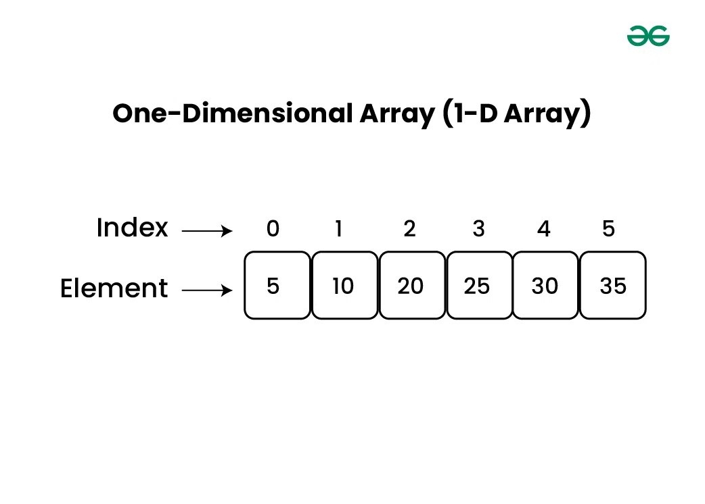
One-dimensional Array(1-D Array)
1-D as a row
Elements stored one after other.
Fig.7: Example of One-dimensional Array
Notes:
New Courses replaced with New Programmes

Slide 24
One-dimensional Array(1-D Array)
# This line creates a 1-D array (list) named numbers with five integer elements.
numbers = [10, 20, 30, 40, 50]
# This statement accesses the element at index 2 of the list.
print(numbers[2])
OUTPUT:
30
Index Explanation
numbers[0] = 10
numbers[1] = 20
numbers[2] = 30
Notes:
New Courses replaced with New Programmes

Slide 25
One-dimensional Array(1-D Array)
# Declare and initialize a 1D array (list in Python)
numbers = [10, 20, 30, 40, 50]
sum = 0 # Variable to store the sum of the array elements
# Loop through the list
for i in range(5):
sum += numbers[i] # Add each element to sum
# Output the sum of the array elements
print("Sum of the array elements is:", sum)
OUTPUT:
Sum of the array elements is: 150
Explanation:
Array Declaration and Initialization:
The array numbers is declared with a size of 5, meaning it can hold 5 integers. It is initialized with the values {10, 20, 30, 40, 50}.
Sum Calculation: A for loop iterates through each element of the array. The variable sum accumulates the total of the array elements as the loop progresses.
Output: After the loop completes, the total sum of the array elements is printed.
Notes:
New Courses replaced with New Programmes

Slide 26
Quick Check
What is the index of the first element of an array?
How many elements are there in the array [5, 10, 15]?
Predict the output:
arr = [1, 2, 3]
print(arr[1])
Identify the Error
arr = [1, 2, 3]
print(arr[3])
Notes:
New Courses replaced with New Programmes

Slide 27
Quick Check
Fill in the Blanks
arr = [5, 10, 15]
print(arr[ __ ])
Trace the Array
arr = [1, 2, 3]
print(arr[1])
Index | Value
0 | ?
1 | ?
2 | ?
Notes:
New Courses replaced with New Programmes

Slide 28
Practice Questions
Write Python code to create an array with 3 numbers
Print the first element
Print the last element
Notes:
New Courses replaced with New Programmes

Slide 29
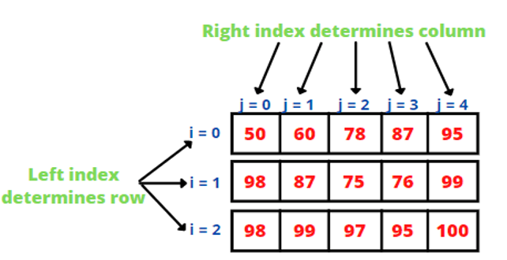
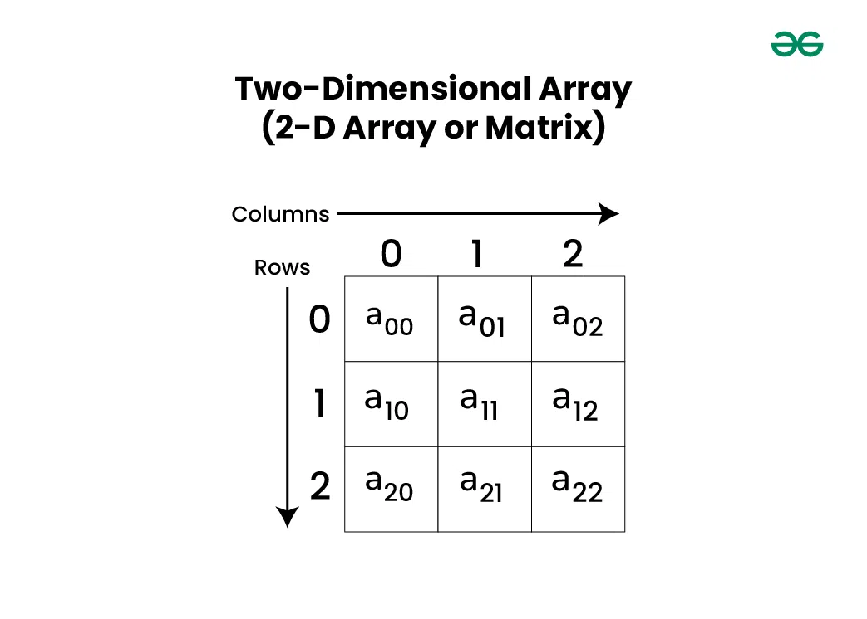
Two-dimensional Array(2-D Array)
Array of arrays
Consists of rows and columns
A 2-D array stores data in rows and columns
Also called a matrix
Fig.8 (a): Examples of Two-dimensional Array
Notes:
New Courses replaced with New Programmes

Slide 30
2-D Array Memory Layout
Rows and Columns
Rows → Horizontal
Columns → Vertical
Index Format
array[row][column]
Example:
matrix[1][2]
Fig.8 (b): Example of Two-dimensional Array
Notes:
New Courses replaced with New Programmes

Slide 31
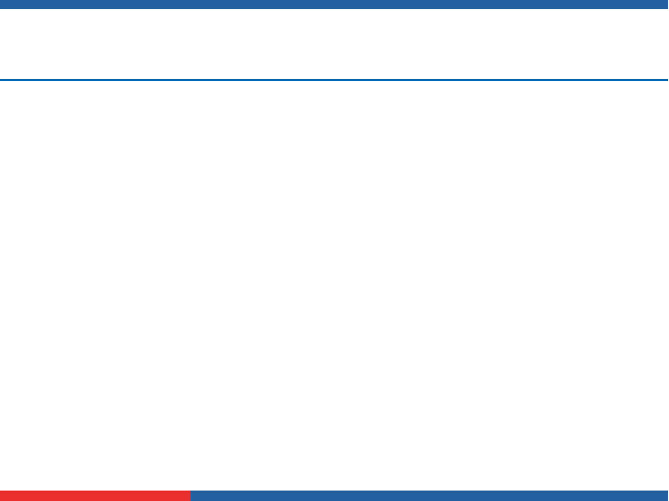
Worked Example – 2-D Array
matrix = [
[1, 2],
[3, 4]
]
#Traversal Using Loops
for i in range(2):
for j in range(2):
print(matrix[i][j])
OUTPUT:
1 2
3 4
Explanation:
2D Array Declaration and Initialization: The variable matrix is declared as a 2-dimensional array (list of lists) and initialized with integers arranged in a 2 × 2 format. This represents a simple matrix with 2 rows and 2 columns.
Traversal Using Nested Loops:
Two nested for loops are used to traverse the matrix.
The outer loop (i) iterates through the rows.
The inner loop (j) iterates through the columns. Each element is accessed using matrix[i][j].
Output: The program prints all elements of the matrix row by row. As a result, the values 1 2 are printed from the first row and 3 4 from the second row.
Notes:
New Courses replaced with New Programmes

Slide 32
Two-dimensional Array (2-D Array)
# Declare and initialize a 2D array (3x3 matrix)
matrix = [
[1, 2, 3],
[4, 5, 6],
[7, 8, 9]
]
# Declare a 2D array to store the transpose
transpose = [[0 for _ in range(3)] for _ in range(3)]
# Compute the transpose of the matrix
for i in range(3):
for j in range(3):
transpose[j][i] = matrix[i][j]
# Print the transpose matrix
print("Transpose of the matrix:")
for row in transpose:
print(row)
Explanation:
2D Array Declaration and Initialization: The variable matrix is declared as a 2-dimensional array and initialized with integers arranged in a 3 × 3 layout. This represents a simple square matrix with three rows and three columns.
Transpose Calculation:
Another 2D array named transpose is created to store the transposed matrix. A pair of nested loops is used to compute the transpose:
The outer loop (i) iterates through the rows of the original matrix.
The inner loop (j) iterates through the columns. Each element at position matrix[i][j] is assigned to transpose[j][i], effectively swapping rows and columns.
Output: The program prints the transposed matrix row by row. Each element is accessed using its row (i) and column (j) indices, resulting in the output.
Transpose of the matrix:
[1, 4, 7]
[2, 5, 8]
[3, 6, 9]
Notes:
New Courses replaced with New Programmes

Slide 33
Quick Check
Q. Trace the Matrix
5 6
7 8
What is the value at matrix[1][0]?
What is the value at matrix[0][1]?
What is the value at matrix[1][2]?
Notes:
New Courses replaced with New Programmes

Slide 34
Practice Questions
Write a program to:
Store 5 elements in a 1-D array
Find their sum
Write a program to:
Add all elements of a 2-D array
Notes:
New Courses replaced with New Programmes

Slide 35
Comparison & Review
Feature | 1-D Array | 2-D Array
Indexing | Single | Row & Column
Structure | Linear | Matrix/Table
Usage | List of items | Tables, grids
Notes:
New Courses replaced with New Programmes

Slide 36
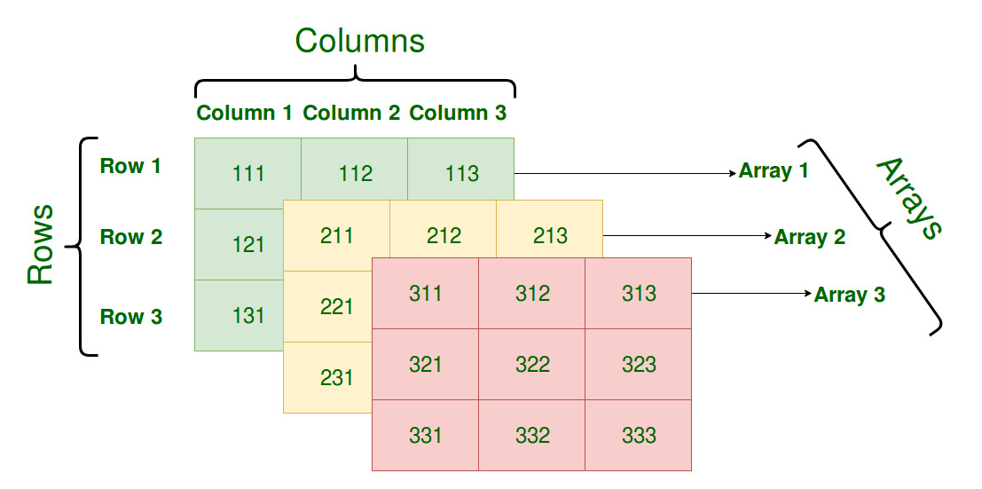
Three-dimensional Array (3-D Array)
Three dimensions
An array of 2-dimensional arrays.
Fig.9: Examples of Three -dimensional Array
Notes:
New Courses replaced with New Programmes

Slide 37
Key Takeaways (Summary)
1-D arrays store data in a single line
2-D arrays store data in rows and columns
Indexing usually starts from 0
Correct indexing avoids errors
Arrays make programs organized and efficient
3-D Arrays are arrays of 2-D arrays
Notes:
New Courses replaced with New Programmes

Slide 38
Multiple Choice Questions
Q1 What is an array?
a) A linear data structure
b) A collection of elements of the same type
c) A container that stores elements in a contiguous memory block
d) All of the above
Q2 What is the index of the first element in an array?
a) 0
b) 1
c) -1
d) It depends on the programming language
Notes:
New Courses replaced with New Programmes

Slide 39
Multiple Choice Questions (Cont..)
Q3 Which of the following statements is true about arrays?
a) Arrays can store elements of different data types.
b) Arrays can automatically resize themselves to accommodate more elements.
c) Arrays have a fixed size determined at compile time.
d) Arrays are not supported in programming languages.
Q4 Which of the following is an example of a dynamic array?
a) ArrayList in Java
b) int array[10] in C++
c) Arrays.copyOf() in Python
d) None of the above
Notes:
New Courses replaced with New Programmes

Slide 40
Situation- Based Questions
Q1 You are working on a scientific simulation that involves modeling weather patterns across a geographical area. Each grid cell in the simulation has various weather attributes, but many cells have default values due to the sparse nature of weather phenomena. Which type of array would you use to represent the weather data efficiently?
Q2 You are developing a game where players move around on a game board represented by a grid. Each cell in the grid can either be empty or contain an obstacle. How would you represent this game board using arrays, and which type of array would be most appropriate?
Notes:
New Courses replaced with New Programmes

Slide 41
Situation- Based Questions
Q3 You are developing a program to manage a library's collection of books. Each book has a different number of authors, and you want to efficiently store this information. Which type of array would you select for representing the authors of each book?
Notes:
New Courses replaced with New Programmes

Slide 42
Multiple Choice Questions (Answers)
A1: d) All of the above
A2: a) 0a) Array
A3: c) Arrays have a fixed size determined at compile time.
A4: a) ArrayList in Java
Notes:
New Courses replaced with New Programmes

Slide 43
Situation- Based Questions (Answers)
A1: Sparse array, as it efficiently handles datasets with many default or empty values, which is common in weather simulations.
A2: 2D array, as it provides a grid-like structure that matches the layout of the game board.
A3: Dynamic array (ArrayList in Java, list in Python), as it can dynamically resize to accommodate varying numbers of authors for each book.
Notes:
New Courses replaced with New Programmes

Slide 44
References
Textbooks
Cormen, T. H., Leiserson, C. E., Rivest, R. L., & Stein, C., Introduction to Algorithms, MIT Press.
Lipschutz, S., Schaum’s Outline of Data Structures with C++, McGraw-Hill Education.
Reference Books
Weiss, M. A., Data Structures and Algorithm Analysis in C++, 5th Edition, Pearson Education.
Skiena, S. S., The Algorithm Design Manual, 3rd Edition, Springer.
Online Resources
GeeksforGeeks, Arrays in Data Structures
https://www.geeksforgeeks.org/array-data-structure/
TutorialsPoint, Data Structures – Arrays
https://www.tutorialspoint.com/data_structures_algorithms/array_data_structure.htm
MIT OpenCourseWare, Introduction to Algorithms
https://ocw.mit.edu
Notes:
New Courses replaced with New Programmes

Slide 45
THANK YOU

